Slide 1
Project Orion
Political outcome prediction
from SWG Values

Slide 2
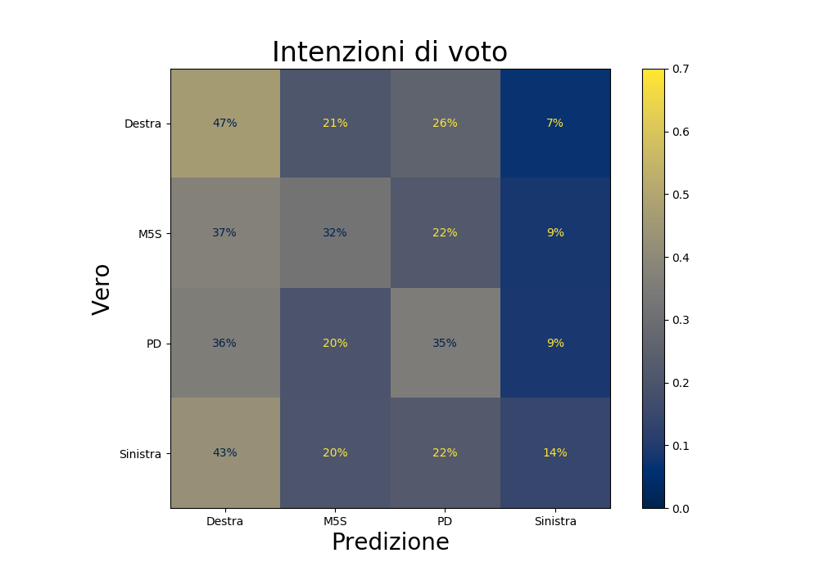
Baseline RF prediction – only demographic feats

Slide 3
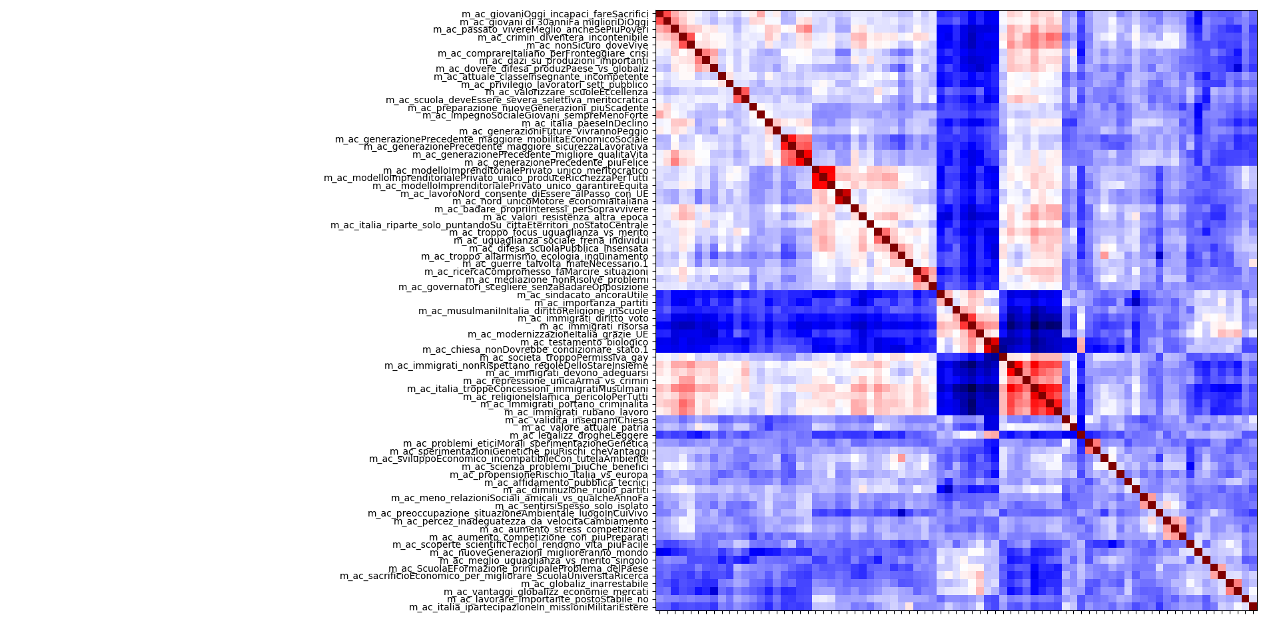
Feature selection – correlations in Valori

Slide 4
Feature selection - |correlations|
Add corr plot w absolute values

Slide 5
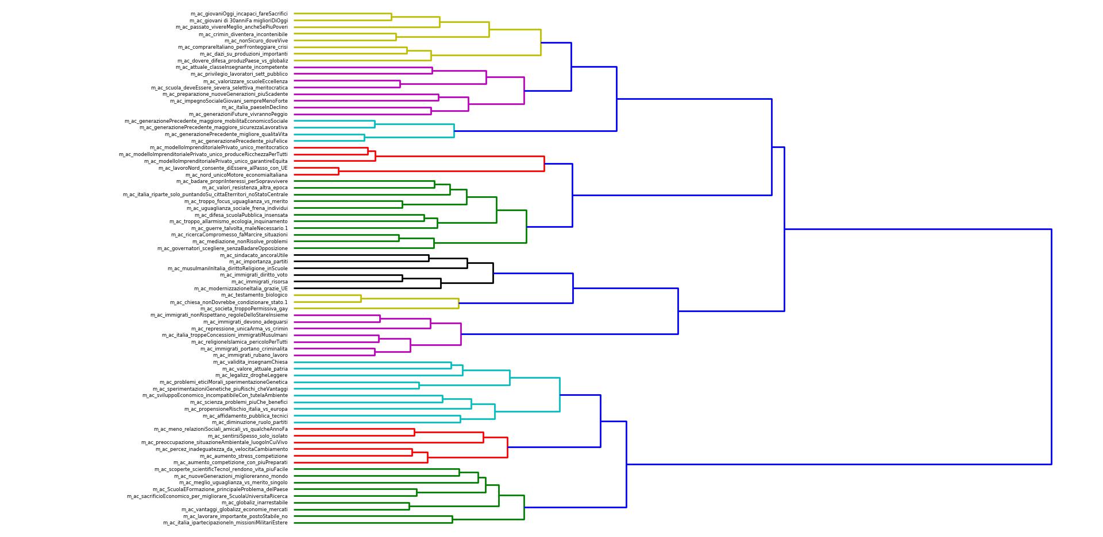
Feature selection – dendrogram of Valori

Slide 6
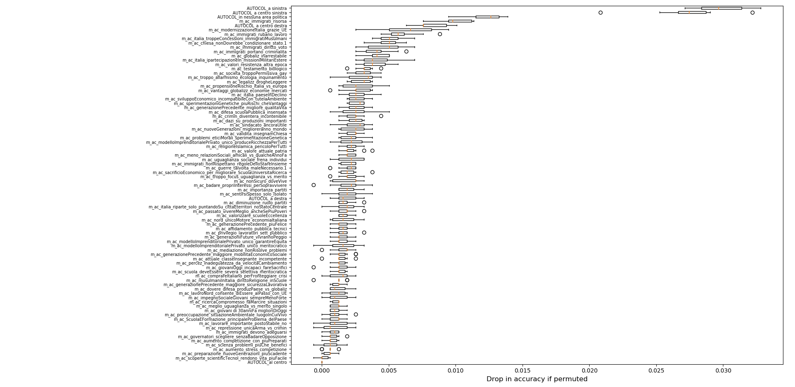
Permutation feature importance – Valori + autocol

Slide 7
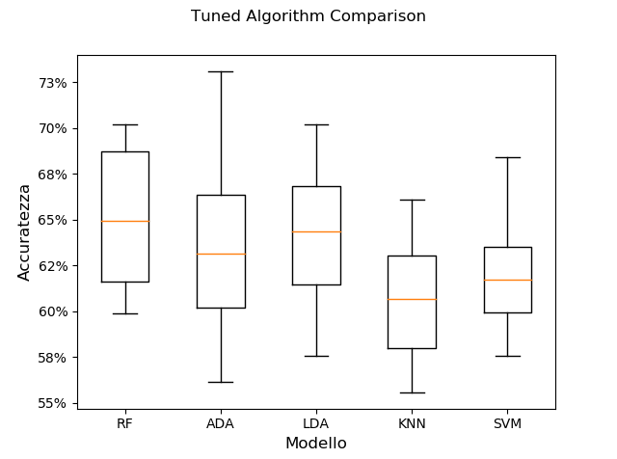
Tuned algorithm comparison
Notes:
RF = Random Forest Classifier
ADA = AdaBoost Classifier
LDA = Linear Discriminant Analysis
KNN = k-Nearest Neighbors Classifier
SVM = Support Vector (Machine) Classifier
Scoring = f1_micro (weighted F1 scores)

Slide 8
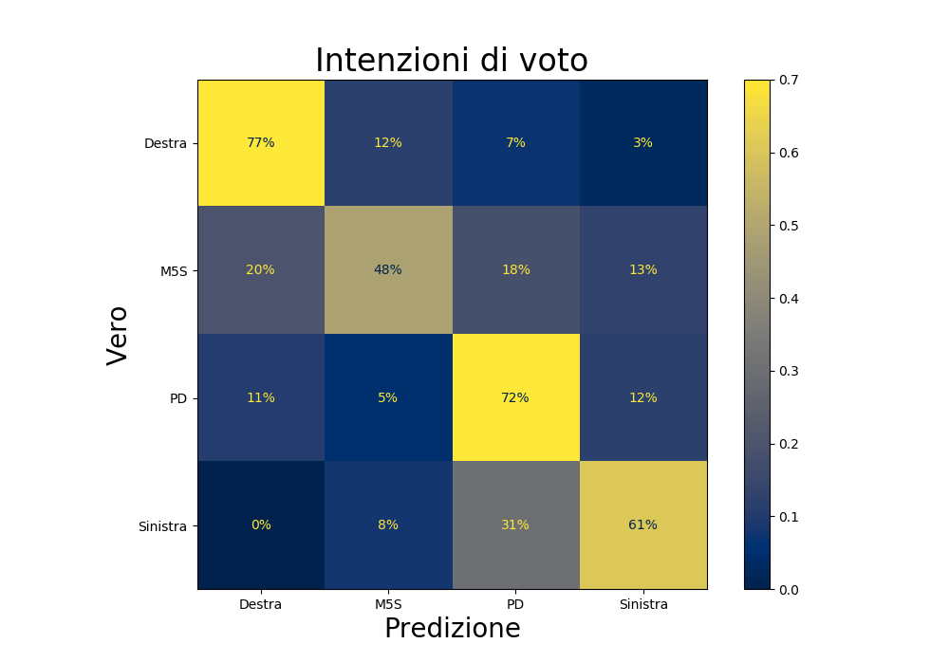
Best RF performance on test data

Slide 9
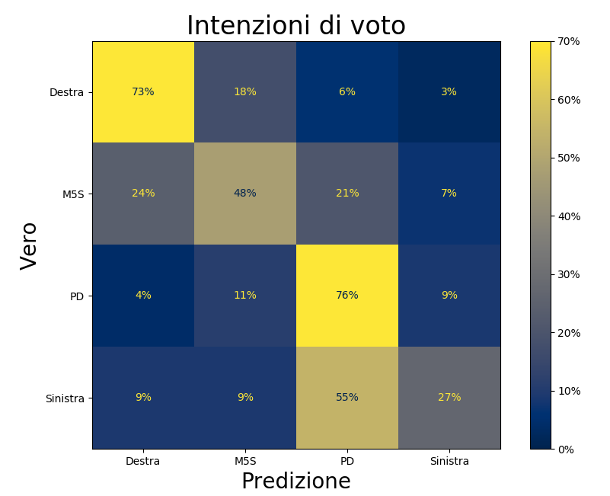
Best RF performance on Omnibus (new data)

Slide 10
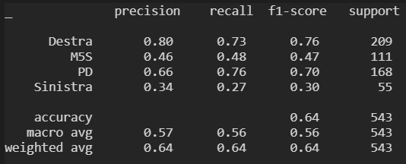
Model performance on new Omnibus

Slide 11
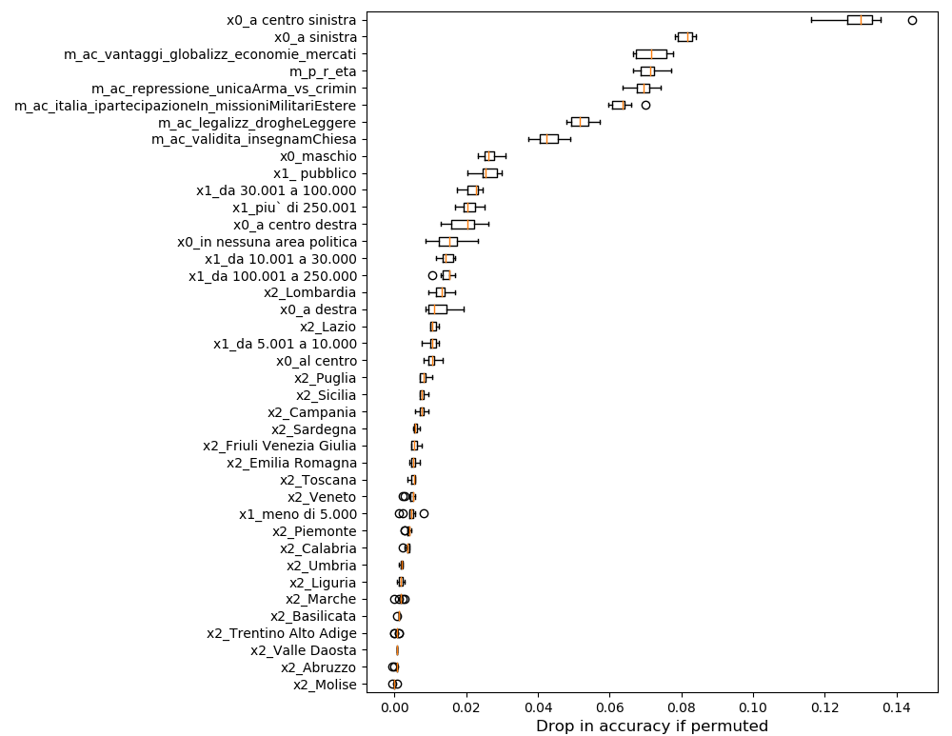
Perm feat importance on Omnibus test

Slide 12
Under development

Slide 13
Model composition experiment on SWG data
Creation of internal CRM from Walden (draft code written)
Selection of V1s and V2s (code ready from prev experiment, to be adapted)
Look for 2-3 V1s best predicted by D + C (M1)
Look for 2-3 V2s best predicted by D + C + V1 (M2)
Report performance results

